Slide 1


Green Pace
Security Policy Presentation
Developer: Craig O’Loughlin

Slide 2

OVERVIEW: DEFENSE IN DEPTH
Protection against modern, complex attacks requires a multi-tiered approach to security, which our security policy aims to follow.

Slide 3
THREATS MATRIX
Security risks across any defensive tier can be classified according to threat, which helps direct resources appropriately
Likely Vulnerabilities that are easy to create and may appear commonly in development. | Priority If a vulnerability is likely, high risk, or easier to resolve, it receives a priority rating.
Unlikely Vulnerabilities that are more difficult to create and appear less often during development. | Low priority If a vulnerability is less likely, lower risk, or harder to resolve, it receives a low priority rating.

Slide 4
10 PRINCIPLES
Validate Input Data
Heed Compiler Warnings
Architect and Design for Security Policies
Keep It Simple
Default Deny
Adhere to the Principle of Least Privilege
Sanitize Data Sent to Other Systems
Practice Defense In Depth
Use Effective Quality Assurance Techniques
Adopt a Secure Coding Standard

Slide 5
CODING STANDARDS
Standard | Priority | Principle(s)
Never pass user input directly to SQL commands | High | Validate Input Data
Do not access or free previously freed memory | High | Keep It Simple / Least Privilege
Do not use deprecated functions | High | Design for Security
Use size_t when dealing with counts and array index | Medium | Architect for Security
Prevent overflow of unsigned integers | Medium | Validate Input Data
Ensure strings do not drop the null terminator | Medium | Heed Compiler Warnings
Do not use out-of-bounds indices | Medium | Validate Input Data
Perform bounds checking when copying inputs | Medium | Validate Input Data
Use assertions for debugging in pre-release builds | Low | Effective QA Techniques
Handle all exceptions before program termination | Low | Design for Security

Slide 6
ENCRYPTION POLICIES
Encryption at rest
Refers to data in storage, such as a database. Encryption of items in storage using strong two-way systems and proper key management provides an extra layer of security on top of existing database access protections.
Encryption in flight
Refers to data in transit, such as over HTTPS channels. Data is the most exposed during transit, such encryption is the main protection scheme and the proper protocols must be followed.
Encryption in use
Refers to data being processed by the application. The principle of least privilege applies, only decrypting for use what is essential and when it is essential.

Slide 7
TRIPLE-A POLICIES
Authentication: Who are you?
Means of authentication include password schemes or more advanced multi-factor systems.
Authorization: What are you allowed to do?
Role-based access applies to choose which types of users can access what. The principle of least privilege applies.
Accounting: What have you done?
Maintaining a record of activity in order to flag suspicious transactions.

Slide 8
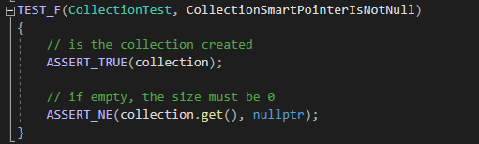

Unit Testing
Example Test 1: Collection Smart Pointer Is Not Null
Google Test Framework (C++) | Sample Result

Slide 9
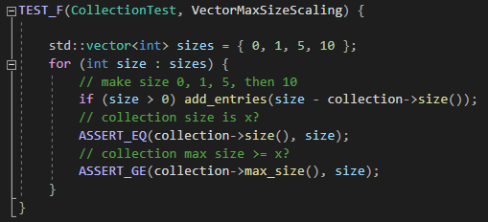

Unit Testing (cont.)
Example Test 2: Vector Max Size Scaling
Google Test Framework (C++) | Sample Result

Slide 10
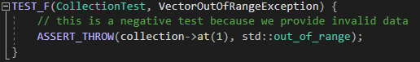

Unit Testing (cont.)
Example Test 3: Out of Range Exception
Google Test Framework (C++) | Sample Result

Slide 11
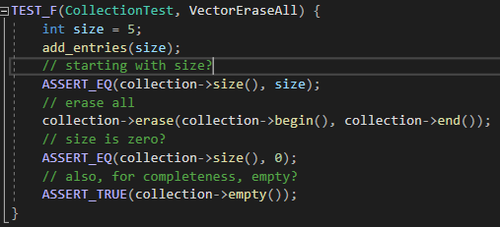

Unit Testing (cont.)
Example Test 4: Erase All Vector Elements
Google Test Framework (C++) | Sample Result

Slide 12

AUTOMATION SUMMARY

Slide 13
TOOLS
Phase | Planning | Building | Testing | Deployment | Observation
Automation Assistance | Threat Modeling: IriusRisk Issue Tracker: Jira Slack | Static Analysis: CppCheck IDE Compiler Warnings: Gcc / Clang | Unit Tests: Google Test Integration: VectorCAST | Runtime Verification: Osquery Config Manage: Docker | Runtime Logic: Alert Logic
(Zettler, n.d.)

Slide 14
RISKS AND BENEFITS
Risks
Leaving security to the end of development
Using outdated security methods
Relying on single security layers
Benefits
Incorporating security into the development pipeline.
Less maintenance costs over the system lifetime (Simko, 2022)
Reduced chance of data breaches and associated penalties

Slide 15
RECOMMENDATIONS
Implement security from project conception onward
Threat Modeling, Security Requirements, ‘Misuser Stories’
Utilize automation for security enforcement
IDE, compilers, static analysis
These tools perform consistently and reliably
Apply multiple layers of security
Authorization and encryption
Firewalls and accounting techniques
Security training
Operators / maintainers / developers
One of the largest data breaches in recent history (Starwood) occurred in part due to lack of security training / awareness
(Fruhlinger, 2020)

Slide 16
CONCLUSIONS
A strong security policy is key to preventing security breaches and subsequent data breaches.
Security must be implemented from the very beginning and continuously throughout the lifecycle.
Security through automation and operation results in a much stronger, more secure, and higher quality final product.

Slide 17
REFERENCES
Zettler, K. (n.d.). The DevSecOp tools that secure DevOps workflows. Atlassian. https://www.atlassian.com/devops/devops-tools/devsecops-tools
Simko, C. (2022, Feb 22). Calculating the roi of sast in DevSecOps for embedded software. GrammaTech. https://blogs.grammatech.com/calculating-the-roi-of-sast-in-devsecops-for-embedded-software
Fruhlinger, J. (2020, Feb 12). Marriot data breach faq: How did it happen and what was the impact? CSO Online. https://www.csoonline.com/article/3441220/marriott-data-breach-faq-how-did-it-happen-and-what-was-the-impact.html

